Slide 1
Introduction to Hadoop

Slide 2
1
Hadoop origins

Slide 3
HDFS Origins
In 1997, Doug Cutting, a co-founder of Hadoop, started working on project Lucene, which is a full-text search library. It was completely written in Java and is a full-text search engine. It analyzes text and builds an index on it. An index is just a mapping of text to locations, so it quickly gives all locations matching search patterns. After a few years, Doug made the Lucene project open source; it got a tremendous response from the community, and it later became the Apache foundation project.
Once Doug realized that he had enough people who can look into Lucene, he started focusing on indexing web pages. Mike Cafarella joined him for this project to develop a product that can index web pages, and they named this project Apache Nutch. Apache Nutch was also known to be a subproject of Apache Lucene, as Nutch uses the Lucene library to index the content of web pages. Fortunately, with hard work, they made good progress and deployed Nutch on a single machine that was able to index around 100 pages per second.
Scalability is something that people often don't consider while developing initial versions of applications. This was also true of Doug and Mike and the number of web pages that could be indexed was limited to 100 million. In order to index more pages, they increased the number of machines. However, increasing nodes resulted in operational problems because they did not have any underlying cluster manager to perform operational tasks. They wanted to focus more on optimizing and developing robust Nutch applications without worrying about scalability issues.
Doug and Mike wanted a system that had the following features:
Fault tolerant: The system should be able to handle any failure of the machines automatically, in an isolated manner. This means the failure of one machine should not affect the entire application.
Load balancing: If one machine fails, then its work should be distributed automatically to the working machines in a fair manner.
Data loss: They also wanted to make sure that, once data is written to disk, it should never be lost even if one or two machines fail.

Slide 4
HDFS Origins
They started working on developing a system that can fulfill the aforementioned requirements and spent a few months doing so. However, at the same time, Google published its Google File System. When they read about it, they found it had solutions to similar problems they were trying to solve. They decided to make an implementation based on this research paper and started the development of Nutch Distributed File System (NDFS), which they completed in 2004.
With the help of the Google File System, they solved the scalability and fault tolerance problem that we discussed previously. They used the concept of blocks and replication to do so. Blocks are created by splitting each file into 64 MB chunks (the size is configurable) and replicating each block three times by default so that, if a machine holding one block fails, then data can be served from another machine. The implementation helped them solve all the operational problems they were trying to solve for Apache Nutch.

Slide 5
MapReduce Origin
Doug and Mike started working on an algorithm that can process data stored on NDFS. They wanted a system whose performance can be doubled by just doubling the number of machines running the program. At the same time, Google published MapReduce: Simplified Data Processing on Large Clusters.
(https://research.google.com/archive/mapreduce.html).
The core idea behind the MapReduce model was to provide parallelism, fault tolerance, and data locality features. Data locality means a program is executed where data is stored instead of bringing the data to the program. MapReduce was integrated into Nutch in 2005. In 2006, Doug created a new incubating project that consisted of HDFS (Hadoop Distributed File System), named after NDFS, MapReduce, and Hadoop Common.
At that time, Yahoo! was struggling with its backend search performance. Engineers at Yahoo! already knew the benefits of Google File System and MapReduce implemented at Google. Yahoo! decided to adopt the capability of Hadoop and they employed Doug to help their engineering team to do so. In 2007, a few more companies who started contributing to Hadoop and Yahoo! reported that they were running 1,000 node Hadoop clusters at the same time.
NameNodes and DataNodes have a specific role in managing overall clusters. NameNodes are responsible for maintaining metadata information. MapReduce engines have a job tracker and task tracker whose scalability is limited to 40,000 nodes because the overall work of scheduling and tracking is handled by only the job tracker. YARN was introduced in Hadoop version 2 to overcome scalability issues and resource management jobs. It gave
Hadoop a new lease of life and Hadoop became a more robust, faster, and more scalable system.

Slide 6
Overview of Hadoop 3
With any such releases, there are some key drivers that lead to its birth. These key drivers create benefits that will ultimately help in the better functioning of Hadoop-augmented enterprise applications. Before we discuss the features of Hadoop 3, you should understand these driving factors. Some driving factors behind the release of Hadoop 3 are as follows:
A lot of bug fixes and performance improvements: Hadoop has a growing open-source community of developers regularly adding major/minor changes or improvements to the Hadoop trunk repository. These changes were growing day by day and they couldn't be accommodated in minor version releases of 2.x. They had to be accommodated with a major version release. Hence, it was decided to release most of these changes committed to the trunk repository with Hadoop 3.
Overhead due to data replication factor: As you may be aware, HDFS has a default replication factor of 3. This helps make things more fault-tolerant with better data locality and better load balancing of jobs among DataNodes. However, it comes with an overhead cost of around 200%. For non-frequently accessed datasets that have low I/O activities, these replicated blocks are never accessed in the course of normal operations. On the other hand, they consume the same number of resources as other main resources. To mitigate this overhead with non-frequently accessed data, Hadoop 3 introduced a major feature, called erasure coding. This stores data durably while saving space significantly.
Improving existing YARN Timeline services: YARN Timeline service version 1 has limitations that impact reliability, performance, and scalability. For example, it uses local-disk-based LevelDB storage that cannot scale to a high number of requests. Moreover, the Timeline server is a single point of failure. To mitigate such drawbacks, YARN Timeline server has been re-architected with the Hadoop 3 release.

Slide 7
Overview of Hadoop 3
Optimizing map output collector: It is a well-known fact that native code (written correctly) is faster to execute. In lieu of that, some optimization is done in Hadoop 3 that will speed up mapper tasks by approximately two to three times. The native implementation of map output collector has been added, which will be used in the Java-based MapReduce framework using the Java Native Interface (JNI). This is particularly useful for shuffle-intensive operations.
The need for a higher availability factor of NameNode: Hadoop is a fault tolerant platform with support for handling multiple data node failures. In the case of NameNodes versions, prior to Hadoop version 3 support two NameNodes, Active and Standby. While it is a highly available solution, in the case of the failure of an active (or standby) NameNode, it will go back to a non-HA mode. This is not very accommodative of a high number of failures. In Hadoop 3, support for more than one standby NameNode has been introduced.
Dependency on Linux ephemeral port range: Linux ephemeral ports are short-lived ports created by the OS (operating system) when a process requests any available port. The OS assigns the port number from a predefined range. It then releases the port after the related connection terminates. With version 2 and earlier, many Hadoop services' default ports were in the Linux ephemeral port range. This means starting these services sometimes failed to bind to the port due to conflicts with other processes. In Hadoop 3, these default ports are moved out of the ephemeral port range.
Disk-level data skew: There are multiple disks (or drives) managed by DataNodes. Sometimes, adding or replacing disks leads to significant data skew within a DataNode. To rebalance data among disks within a DataNode, Hadoop 3 has introduced a CLI utility called HDFS diskbalancer.

Slide 8
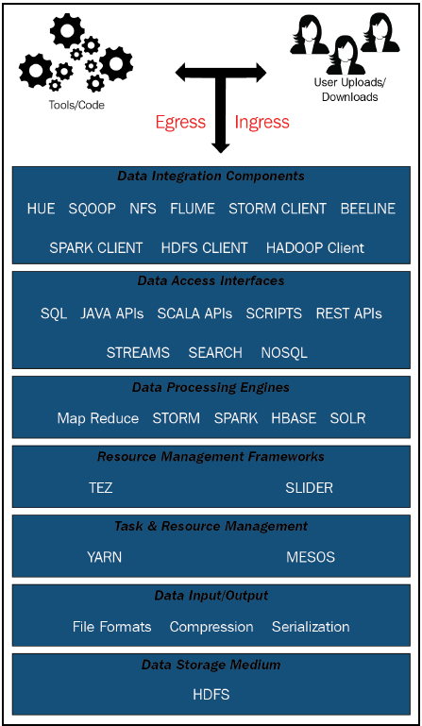
Hadoop Logical View
The Hadoop Logical view can be divided into multiple sections. These sections can be viewed as a logical sequence, with steps starting from Ingress/Egress and ending at Data Storage Medium.

Slide 9
Hadoop Logical View
We will touch upon these sections as shown in the preceding diagram one by one, to understand them. However, when designing any Hadoop application, you should think in terms of those sections and make technological choices according to the use case problems you are trying to solve. Without wasting time, let's look at these sections one by one:
Ingress/egress/processing: Any interaction with the Hadoop platform should be viewed in terms of the following:
Ingesting (ingress) data
Reading (Egress) data
Processing already ingested data
These actions can be automated via the use of tools or automated code. This can be achieved by user actions, by either uploading data to Hadoop or downloading data from Hadoop. Sometimes, users trigger actions that may result in Ingress/egress or the processing of data.
Data integration components: For ingress/egress or data processing in Hadoop, you need data integration components. These components are tools, software, or custom code that help integrate the underlying Hadoop data with user views or actions. If we talk about the user perspective alone, then these components give end users a unified view of data in Hadoop across different distributed Hadoop folders, in different files and data formats. These components provide end users and applications with an entry point for using or manipulating Hadoop data using different data access interfaces and data processing engines. In a nutshell, tools such as Hue and software (libraries) such as Sqoop, Java Hadoop Clients, and Hive Beeline Clients are some examples of data integration components.

Slide 10
Hadoop Logical View
Data access interfaces: Data access interfaces allow you to access underlying Hadoop data using different languages such as SQL, NoSQL, or APIs such as Rest and JAVA APIs, or using different data formats such as search data formats and streams. Sometimes, the interface that you use to access data from Hadoop is tightly coupled with underlying data processing engines. For example, if you’re using SPARK SQL then it is bound to use the SPARK processing engine. Something similar is true in the case of the SEARCH interface, which is bound to use search engines such as SOLR or elastic search.
Data Processing Engines: Hadoop as a platform provides different processing engines to manipulate underlying data. These processing engines have different mechanisms to use system resources and have completely different SLA guarantees. For example, the MapReduce processing engine is more disk I/O-bound (keeping RAM memory usage under control) and it is suitable for batch-oriented data processing. Similarly, SPARK in a memory processing engine is less disk I/O-bound and more dependent on RAM memory. It is more suitable for stream or micro-batch processing. You should choose processing engines for your application based on the type of data sources you are dealing with along with SLAs you need to satisfy.
Resource management frameworks: Resource management frameworks expose abstract APIs to interact with underlying resource managers for task and job scheduling in Hadoop. These frameworks ensure there is a set of steps to follow for submitting jobs in Hadoop using designated resource managers such as YARN or MESOS. These frameworks help establish optimal performance by utilizing underlying resources systematically. Examples of such frameworks are Tez or Slider. Sometimes, data processing engines use these frameworks to interact with underlying resource managers or they have their own set of custom libraries to do so.

Slide 11
Hadoop Logical View
Task and resource management: Task and resource management has one primary goal: sharing a large cluster of machines across different, simultaneously running applications in a cluster. There are two major resource managers in Hadoop: YARN and MESOS. Both are built with the same goal, but they use different scheduling or resource allocation mechanisms for jobs in Hadoop. For example, YARN is a Unix process while MESOS is Linux-container-based.
Data input/output: The data input/output layer is primarily responsible for different file formats, compression techniques, and data serialization for Hadoop storage.
Data Storage Medium: HDFS is the primary data storage medium used in Hadoop. It is a Java-based, high-performant distributed filesystem that is based on the underlying UNIX File System. In the next section, we will study Hadoop distributions along with their benefits.

Slide 12
Hadoop Distributions
Hadoop is an open-source project under the Apache Software Foundation, and most components in the Hadoop ecosystem are also open-sourced. Many companies have taken important components and bundled them together to form a complete distribution package that is easier to use and manage. A Hadoop distribution offers the following benefits:
Installation: The distribution package provides an easy way to install any component or rpm-like package on clusters. It provides an easy interface too.
Packaging: It comes with multiple open-source tools that are well configured to work together. Assume that you want to install and configure each component separately on a multi-node cluster and then test whether it's working properly or not. What if we forget some testing scenarios and the cluster behaves unexpectedly? The Hadoop distribution assures us that we won't face such problems and also provides upgrades or installations of new components by using their package library.
Maintenance: The maintenance of a cluster and its components is also a very challenging task, but it is made very simple in of all these distribution packages. They provide us with a nice GUI interface to monitor the health and status of a component. We can also change the configuration to tune or maintain a component to perform well.
Support: Most distributions come with 24/7 support. That means that, if you are stuck with any cluster-or distribution-related issue, you don't need to worry much about finding resources to solve the problem. Hadoop Distribution comes with a support package that assures you of technical support and help as and when needed.

Slide 13
On-premise Distributions
We will look at the most widely used distributions:
Cloudera: Cloudera is an open-source Hadoop distribution that was founded in 2008, just when Hadoop started gaining popularity. Cloudera is the oldest distribution available. People at Cloudera are committed to contributing to the open-source community and they have contributed to the building of Hive, Impala, Hadoop, Pig, and other popular open-source projects. Cloudera comes with good tools packaged together to provide a good Hadoop experience. They also provide a nice GUI interface to manage and monitor clusters, known as Cloudera manager.
MapR: MapR was founded in 2009 and it has its own filesystem called MapR-FS, which is quite like HDFS but with some new features built by MapR. It boasts higher performance; it also consists of a few nice sets of tools to manage and administer a cluster, and it does not suffer from a single point of failure. It offers some useful features, such as mirroring and snapshots.

Slide 14
2
Introduction to HDFS

Slide 15
Defining HDFS
HDFS is designed to run on a cluster of commodity hardware. It is a fault-tolerant, scalable File System that handles the failure of nodes without data and can scale up horizontally to any number of nodes. The initial goal of HDFS was to serve large data files with high read and write performance.
The following are a few essential features of HDFS:
Fault tolerance: Downtime due to machine failure or data loss could result in a huge loss to a company; therefore, the companies want a highly available fault tolerant system. HDFS is designed to handle failures and ensures data availability with corrective and preventive actions. Files stored in HDFS are split into small chunks and each chunk is referred to as a block. Each block is either 64 MB or 128 MB, depending on the configuration. Blocks are replicated across clusters based on the replication factor. This means that if the replication factor is three, then the block will be replicated to three machines. This assures that, if a machine holding one block fails, the data can be served from another machine.
Streaming data access: HDFS works on a write once read many principle. Data within a file can be accessed by an HDFS client. Data is served in the form of streams, which means HDFS enables streaming access to large data files where data is transferred as a continuous stream. HDFS does not wait for the entire file to be read before sending data to the client; instead, it sends data as soon as it reads it. The client can immediately process the received stream, which makes data processing efficient.
Scalability: HDFS is a highly scalable File System that is designed to store a large number of big files and allows you to add any number of machines to increase its storage capability. Storing a huge number of small files is generally not recommended; the size of the file should be equal to or greater than the block size. Small files consume more RAM space on master nodes, which may decrease the performance of HDFS operations.

Slide 16
Defining HDFS
Simplicity: HDFS is easy to set up and manage. It is written in Java. It provides easy command-line interface tools that are very much similar to Linux commands. Later in this chapter, we will see how easy it is to operate HDFS via a command-line utility.
High availability: HDFS is a highly available distributed File System. Every read and write request goes to a master node, and a master node can be a single point of failure. Hadoop offers the high availability feature, which means a read and write request will not be affected by the failure of the active master node. When the active master node fails, the standby master node takes over. In Hadoop version 3, we can have more than two master nodes running at once to make high availability more robust and efficient.

Slide 17
YARN Resource Management
3

Slide 18
Architecture
YARN stands for Yet Another Resource Negotiator, and was introduced with Apache Hadoop 2.0 to address the scalability and manageability issues that existed with the previous versions. In Hadoop 1.0, we have two major components for job execution:
JobTracker and task tracker. JobTracker is responsible for managing resources and scheduling jobs. It is also responsible for tracking the status of each job and restarting them if there is any failure. The task trackers are responsible for running tasks and sending progress report to JobTracker. The JobTracker also reschedules failed tasks on different task trackers. As JobTracker could be overloaded with multiple tasks, Hadoop 1.0 made several changes in its architecture to eliminate the following limitations:
Scalability: In Hadoop 1.0, the JobTracker is responsible for scheduling the jobs, monitoring each job, and restarting them on failure. It means JobTracker spends the majority of its time managing the application's life cycle. In a larger cluster with more nodes and more tasks, the burden of scheduling and monitoring increases. The work overhead limits the scalability of Hadoop version 1 to 4,000 nodes and 40,000 tasks.
High availability: High availability ensures that even if one node serving the request goes down, the other standby active node can assume the responsibility for the failed node. In this case, the state of the failed node should be in sync with the state of the standby active node. The JobTracker is a single point of failure. Every few seconds, task trackers send the information about tasks to the JobTracker, which makes it difficult to implement high availability for the JobTracker because of the large number of changes in a very short span of time.
Memory utilization: Hadoop version 1 required preconfigured task tracker slots for map and reduce tasks. The slot reserved for the map task cannot be used for the reduce task or the other way around. The efficient utilization of task trackers’ memory was not possible on account of to this setup.

Slide 19
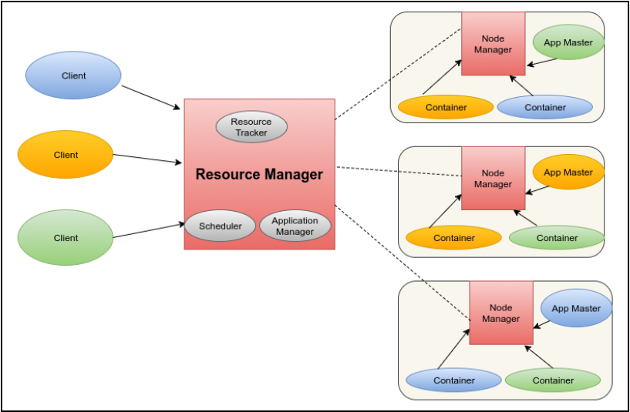
Architecture
YARN consists of two major components: Resource Manager and the Node Manager. The Resource Manager is a master node that is responsible for managing resources in the cluster. Per-application Application Master running on the Node Manager is responsible for launching and monitoring containers of jobs. The cluster consists of one Resource Manager and multiple Resource Manager, as seen in the following diagram:

Slide 20
Architecture
The preceding diagram can be explained as follows:
Resource Manager: The Resource Manager is a master daemon that is responsible for managing the resources of submitted applications. It has two primary components:
Scheduler: The job of Resource Manager Scheduler is to allocate the required resources requested by the per application application master. The job of Scheduler is to only schedule the job, which means it does not monitor any task and is not responsible for relaunching any failed application container. The application makes a request of job scheduling to the YARN and YARN sends detailed scheduling information, including the amount of memory required for the job. Upon receiving the scheduling request, the Scheduler simply schedules the job.
Application Manager: The job of the Application Manager is to manage per application master. Each application submitted to the YARN will have its own application master and the Application Manager keeps track of each application master. Each client request for job submission is received by the Application Manager and it provides resources to launch application master for the application. It also destroys the application master upon completion of the application execution. When cluster resources become limited and already in use, the Resource Manager can request back the resources from a running application so that it can allocate it to the application.
Node manager: The Node Manager is a slave that runs on every worker node of a cluster and has responsibility for launching and executing containers based on instructions from the Resource Manager. The Node Manager sends heartbeat signals to the Resource Manager, and which also contain some other information, including Node Manager machine details, and available memory. The Resource Manager regularly updates the information of each Node Manager upon receiving the request, which helps in planning and scheduling upcoming tasks. The containers are launched on the Node Manager and the application master is also launched on the Node Manager container.

Slide 21
Architecture
Application master: The first step of the application is to submit the job to YARN, and upon receiving the request of a job submission, YARN's Resource Manager launches the application master for that particular job on one of the Node Manager Container. The application master is then responsible for managing application execution in the cluster. For each application, there will be a dedicated application master running on some Node Manager Container that is responsible for coordinating between Resource Manager and Node Manager in order to complete the execution of the application. The application master requests the required resources for application execution from the Resource Manager and the Resource Manager sends the detailed information about the Resource Container to the application master, which then coordinates with the respective Node Manager to launch the container to execute the application task. The application master sends heartbeats at regular intervals to the Resource Manager and updates its resource usage. The application master changes the plan of execution depending upon the response received from the Resource Manager.

